Slide 1
Estimating QoS with ML Filip Krasniqi, Jocelyne Elias and Jérémie Leguay 26/09/2019

Slide 2
Introduction
Estimating QoS is a hard problem
The space exploration is composed of a lot of parameters: topology, number of nodes, routing policy, traffic intensity, traffic distribution…
It means that we are learning the relation between the QoS metrics and all these features!
About Machine Learning
Supervised Learning problem - Regression
We choose Deep Learning (DL) as the Machine Learning family
Most of these features are not even easy to describe in a way s.t. DL techniques can handle with them

Slide 3
Overview
Summary 17/07
SoA: Understanding NN (1), DeepQ (2). Routenet (3)
Dataset analysis, implementation of (1)
Simulations (ns3)
Given topology T, draw E environments, I intensities depending on the environments. Results: IxE datasets
Targets: per link delay, e2e delay, per link load
Features: traffic matrix, dropped packets, some link properties (capacity, queue size), routing scheme
Updates
Scenario: fixed a topology, learn e2e delay D in case of unseen (capacities distribution, traffic rates) using as feature the traffic matrix TM. D = F(TM).
RF
Time series
DL
Sequence-based learning -> RNN
Graph structure -> Graph NN
Goals
Obtain good test results on unseen simulations
Provide a GNN-based model on this scenario (new)
Compare DL with a traditional ML technique on this context (RF)
Notes:
During goals, remind that (1) and (3) are simulating data in a scenario on which you have lower rate and lower capacity (C = 10Kbps for each link)

Slide 4
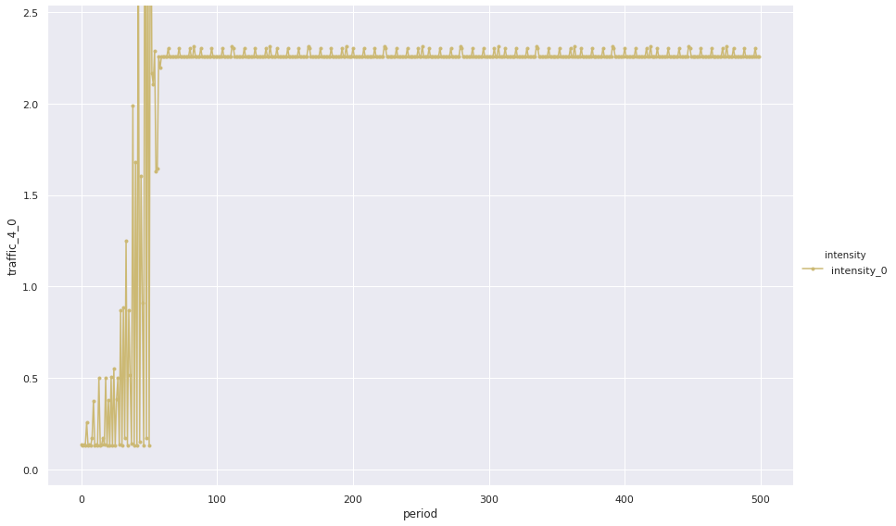
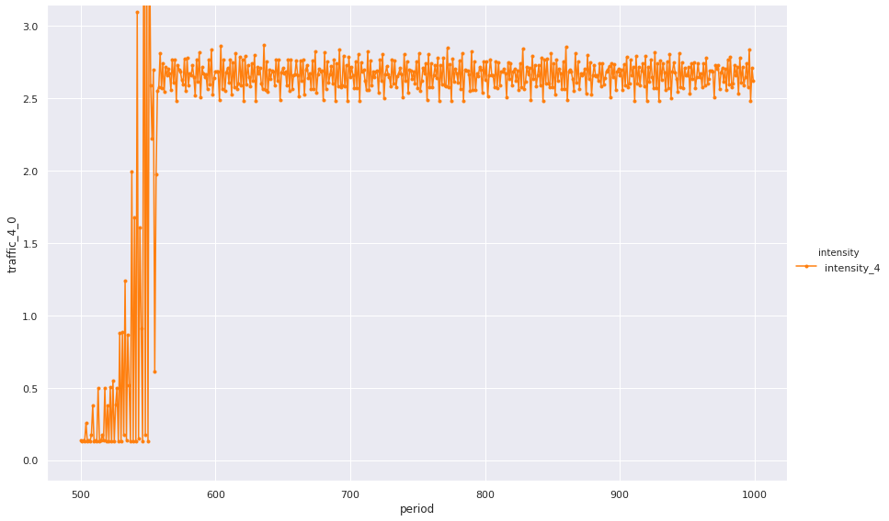
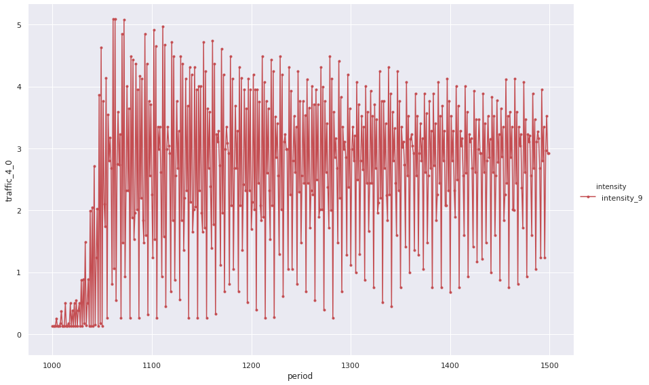
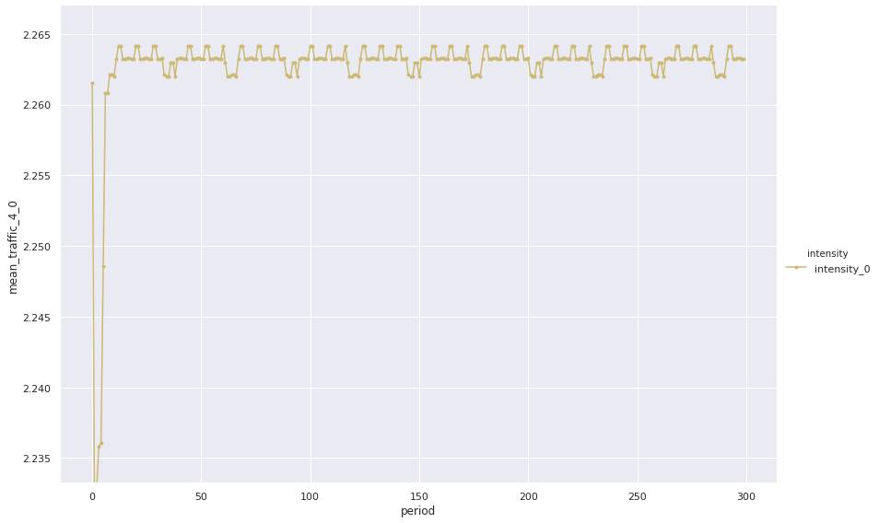
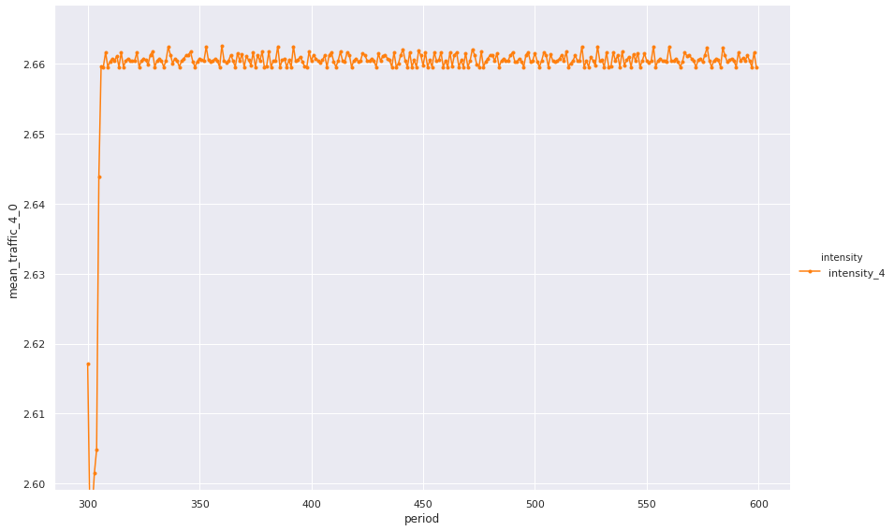
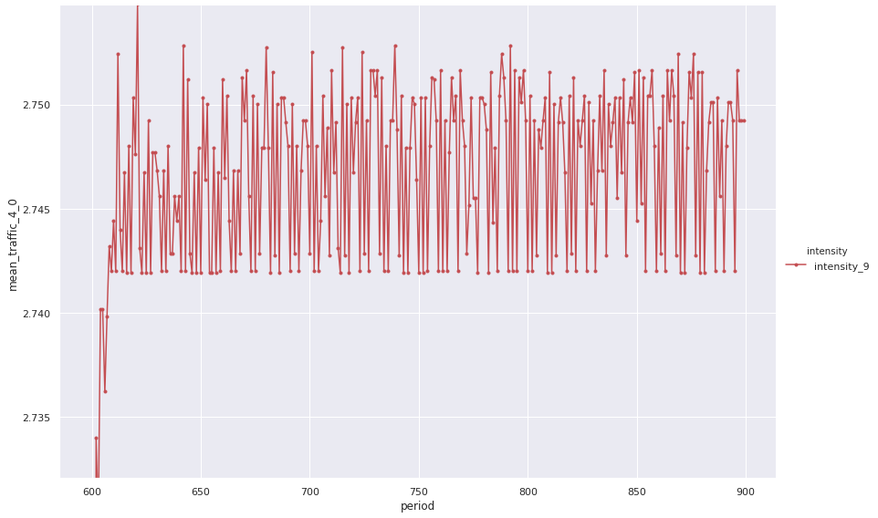
Raw data (1/2) : TM
Low intensity | Medium intensity | High intensity
Raw Traffic Matrix
Averaged TM
Traffic is related to one selected OD flow (4 – 0), for one specific environment, thus related to 50s = 500 periods
Notes:
Avg: WS = 100

Slide 5
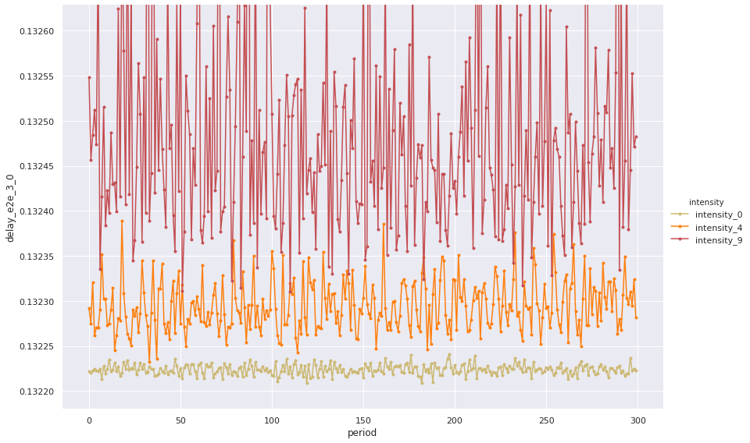
Raw data (2/2) : e2e delay

Slide 6
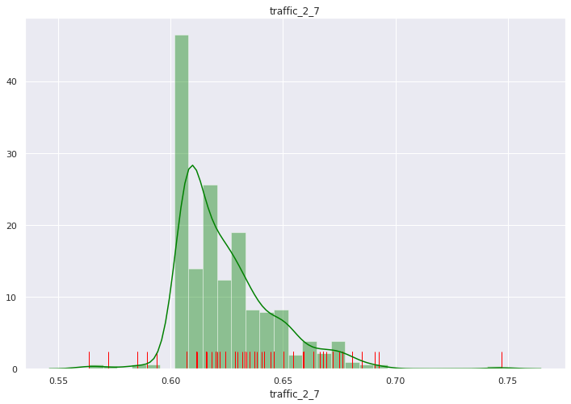
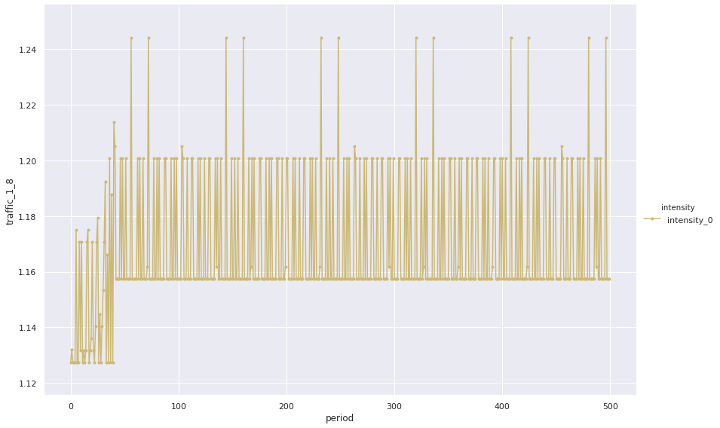
Random Forest
1
Data cleaning: removed first second from each ns3 simulation
Feature extraction: defined window of size W = 50, computed quantiles q01, q10, q20, …, q90, q99, average, std -> huge amount of features that will be selected by the algorithm
e2eD is a NxN matrix, same for T. This means that given a network of size N we are providing in input N^2 * 13 features (eg: Abilene is 12 nodes -> 1872 features)
2
1
2

Slide 7

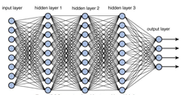
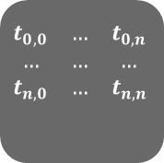

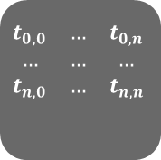
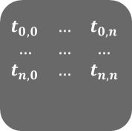
DL: sequence-based learning
Data cleaning (1)
Data preparation for the model (online)
$$\begin{matrix}t_{0,0} & … & t_{0,n} \\ … & … & … \\ t_{n,0} & … & t_{n,n}\end{matrix}$$
DL: input as a sequence
_{Extracted} features from timeseries
MLP (ModuleList of Hidden Blocks)
1
$$\begin{matrix}t_{0,0} & … & t_{0,n} \\ … & … & … \\ t_{n,0} & … & t_{n,n}\end{matrix}$$
Loader
2
…
$$\begin{matrix}t_{0,0} & … & t_{0,n} \\ … & … & … \\ t_{n,0} & … & t_{n,n}\end{matrix}$$
W-1
$$\begin{matrix}t_{0,0} & … & t_{0,n} \\ … & … & … \\ t_{n,0} & … & t_{n,n}\end{matrix}$$
W
Notes:
Remind
point 2 is only done for each batch as it is online
Hidden Block: Linear + BatchNorm + Dropout + Activation Function
Emphasize lack of graph information

Slide 8
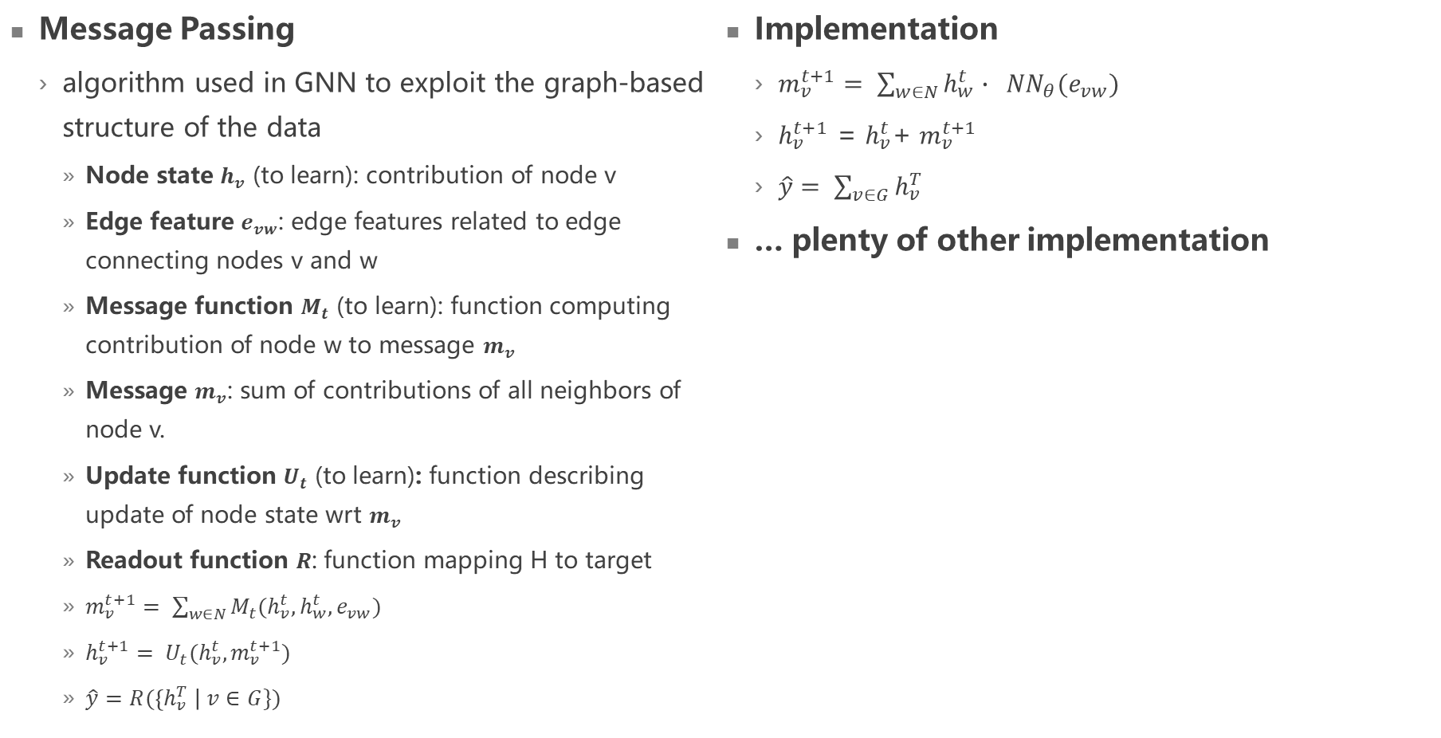
DL: graph structure (1/2)
Message Passing
algorithm used in GNN to exploit the graph-based structure of the data
Node state $h_{v}$ (to learn): contribution of node v
Edge feature $e_{vw}$: edge features related to edge connecting nodes v and w
Message function $M_{t}$ (to learn): function computing contribution of node w to message $m_{v}$
Message $m_{v}$: sum of contributions of all neighbors of node v.
Update function $U_{t}$ (to learn): function describing update of node state wrt $m_{v}$
Readout function $R$: function mapping H to target
$m_{v}^{t+1}= \sum_{w∈N}{M_{t}(h_{v}^{t},h_{w}^{t}, e_{vw})}$
$h_{v}^{t+1}= U_{t}(h_{v}^{t},m_{v}^{t+1})$
$\hat{y}=R(\left\{h_{v}^{T} \right| v∈G\})$
Implementation
$m_{v}^{t+1}= \sum_{w∈N}{h_{w}^{t}∙ {NN}_{θ}(e_{vw})}$
$h_{v}^{t+1}$ = $h_{v}^{t}$+ $m_{v}^{t+1}$
$\hat{y}= \sum_{v∈G}{h_{v}^{T}}$
… plenty of other implementation
Notes:
Underline NNConv, i.e., algorithm from which RouteNet was taken from
Explanation of how the graph structure is exploited
Message computation: for node V, sum of the contribute of each neighbours. This contribute is the function M, that depends on node v, w and edge. Information of node is the hidden state, that is unknown -> to be learned
Update function, i.e., allows to learn the hidden state -> depends on node and on the message
So far we computed the hidden space that will be used to do the prediction
Readout function: maps hidden states to output
Implementation
Message: computes the mapping from feature space to hidden space using edge features. H is a learnable function
Update function: computes new hidden states by summing previous one to the computed message
Readout function: aggregates the nodes by summing the hidden states.

Slide 9
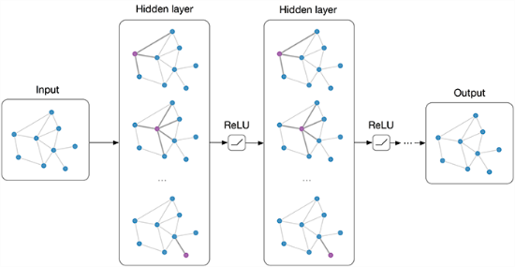

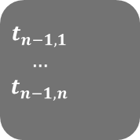
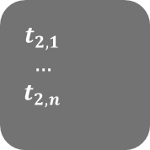
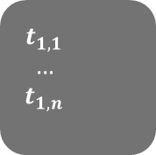
DL: graph structure (2/2)
Data cleaning (1)
Data preparation for the model (offline)
$$\begin{matrix}t_{1,1} & & \\ … & & \\ t_{1,n} & & \end{matrix}$$
1
1
…
Graph NN
N
$$\begin{matrix}t_{2,1} & & \\ … & & \\ t_{2,n} & & \end{matrix}$$
2
1
…
…
N
$$\begin{matrix}t_{n−1,1} & & \\ … & & \\ t_{n−1,n} & & \end{matrix}$$
N-1
1
…
N
$$\begin{matrix}t_{n,1} & & \\ … & & \\ t_{n,n} & & \end{matrix}$$
N
1
…
N

Slide 10

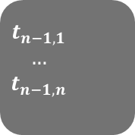


DL: DeepG
Data cleaning (1)
Data preparation for the model (offline)
$$\begin{matrix}t_{1,1} & & \\ … & & \\ t_{1,n} & & \end{matrix}$$
1
DL: input as a sequence
_{Extracted} features from timeseries
Graph NN
1
1
…
N
$$\begin{matrix}t_{2,1} & & \\ … & & \\ t_{2,n} & & \end{matrix}$$
2
1
1
…
…
N
$$\begin{matrix}t_{n−1,1} & & \\ … & & \\ t_{n−1,n} & & \end{matrix}$$
W
N-1
1
…
N
$$\begin{matrix}t_{n,1} & & \\ … & & \\ t_{n,n} & & \end{matrix}$$
W
N
1
…
N

Slide 11
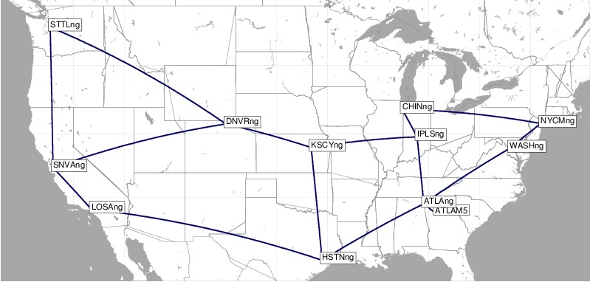
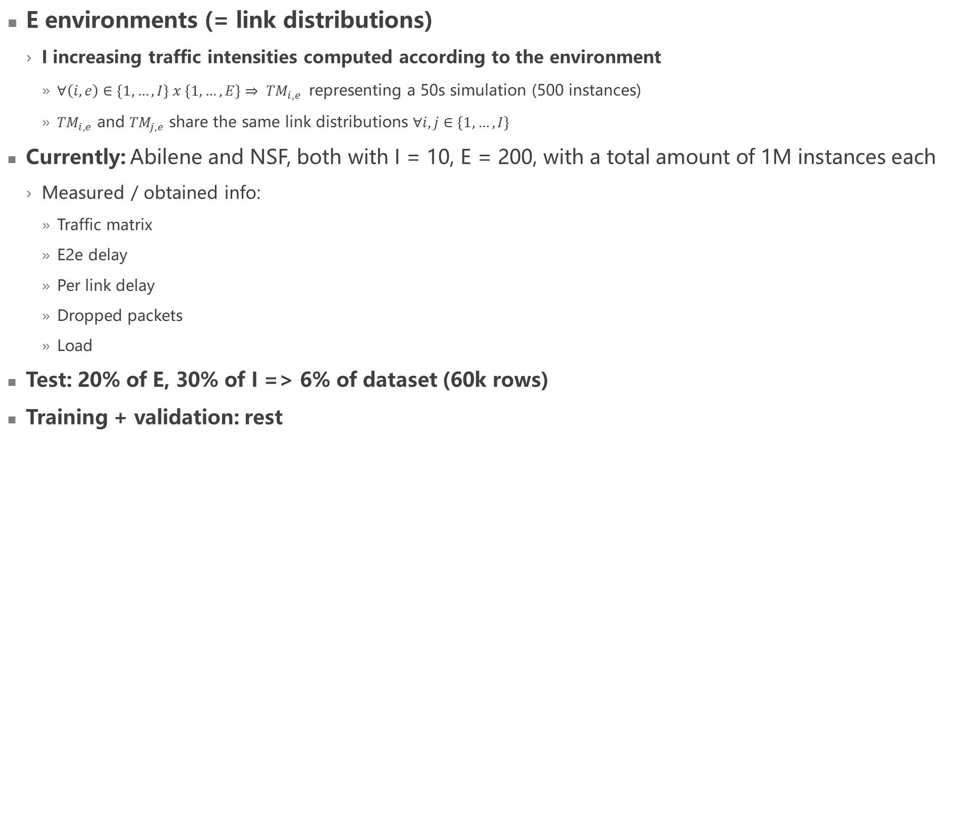
Datasets
E environments (= link distributions)
I increasing traffic intensities computed according to the environment
$∀\left(i, e\right)∈\left\{1, …, I\right\} x \left\{1, …, E\right\}⇒ {TM}_{i, e}$ representing a 50s simulation (500 instances)
${TM}_{i, e}$ and ${TM}_{j, e}$ share the same link distributions $∀i, j∈\left\{1, …, I\right\}$
Currently: Abilene and NSF, both with I = 10, E = 200, with a total amount of 1M instances each
Measured / obtained info:
Traffic matrix
E2e delay
Per link delay
Dropped packets
Load
Test: 20% of E, 30% of I => 6% of dataset (60k rows)
Training + validation: rest
Abilene

Slide 12
Training
RF regressor (sklearn)
Randomized search with stratified Kfold CV
Space of exploration
max_depth
max_features
min_samples_split
n_estimators
Criterion: MSE
Score: R2 -> 0.48
DeepG (pytorch)
Own CV
Validation is selected in the same way as test
Own gridsearch
Model still training…
Criterion: MSE
Notes:
RF: Search not working well. Doubt on learning capability that would justify this behavior
DeepG: before using gridsearch trying with just one setting

Slide 13
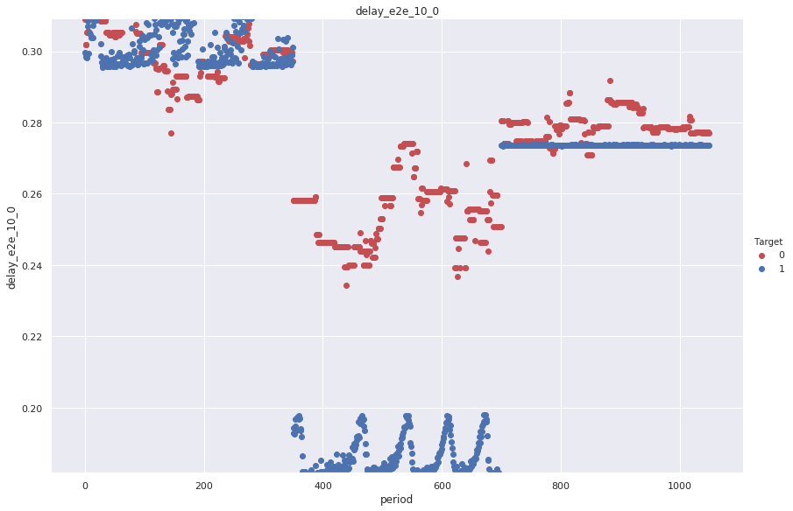
RF: WS = 50

Slide 14
Next steps
Improve algorithm to reach a satisfying score
Generalization over routing
Simulation: solve M routing with Dijkstra SP with weights
Each link has weight w = 1 + U(0, K)
Noise shouldn’t affect much the solution
Sample R routing settings among the M generated ones
Dataset will be composed of R x I x E sub-datasets
Learning: Graph NN with in input the routing

